Slide 1

Sardar Patel College of Engineering, Bakrol
Mr. Bharat Vadhiya
Assistant Professor
Department of H & AS
Subject : CPDP (3150004)
Semester : 5
Chapter : 2

Slide 2


Slide 3


Slide 4


Slide 5


Slide 6
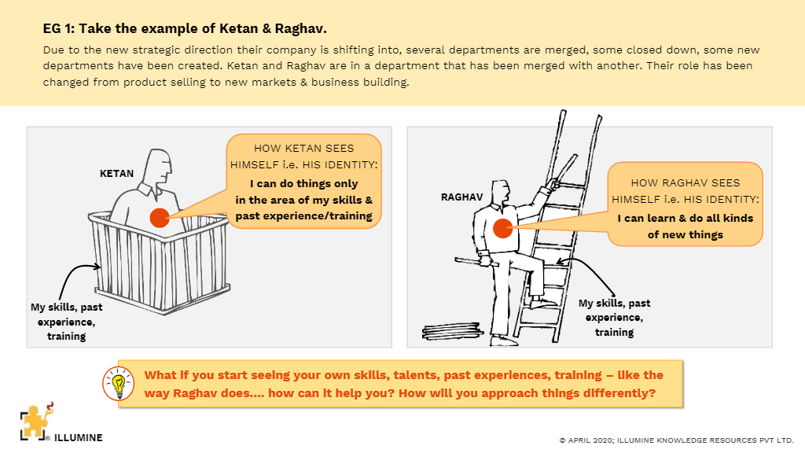

Slide 7


Slide 8
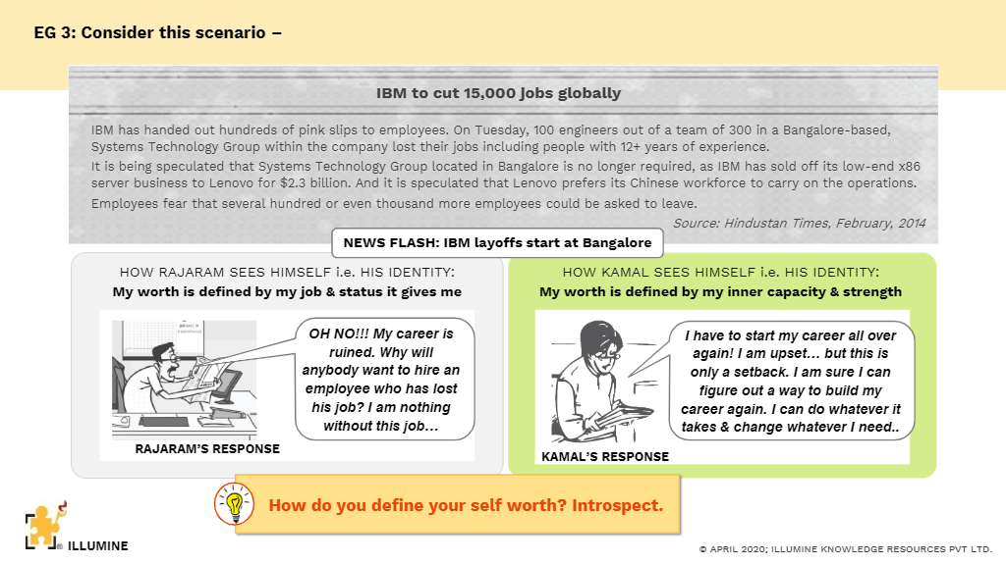

Slide 9


Slide 10


Slide 11


Slide 12


Slide 13


Slide 14
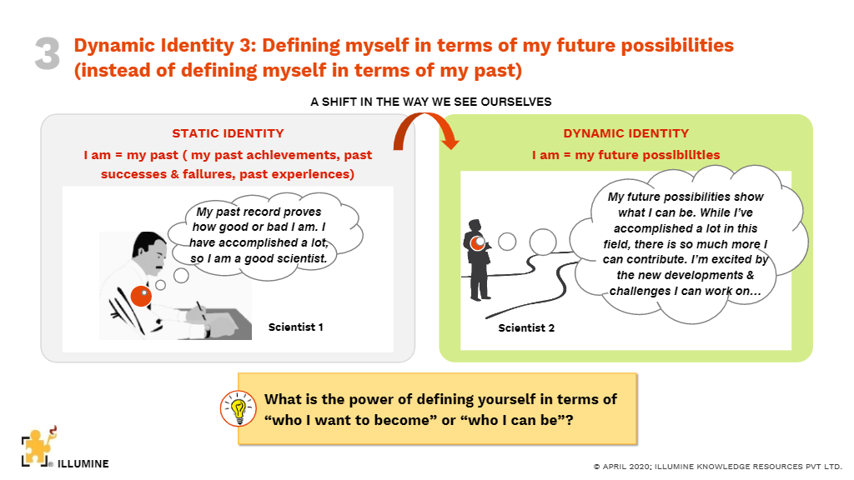

Slide 15
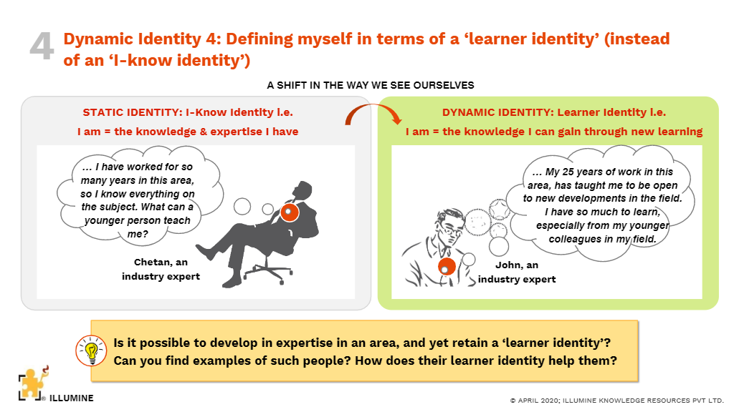

Slide 16


